Slide 1


Code Park: A New 3D Code Visualization Tool
Pooya Khaloo∗, Mehran Maghoumi†, Eugene Taranta II‡, David Bettner§, Joseph Laviola Jr¶.
University Of Central Florida
speaker: YingJian Xiao

Slide 2
Contents
01. Introduction
02. Related Work
03. User Interface Design
04. Evaluation:Code Park Usability
05. Evaluation:Understanding Project Organization
06. Limitations And Future Work
07. Conclusion

Slide 3
1.Introduction
Code Park(CP), a new 3D code visualization tool that aims to improve a programmer’s understanding of an existing codebase in a manner that is both engaging and fun.
CP organizes source code into a 3D scene in order to take advantage of human’s spatial memory capabilities and help one better understand and remember the architecture.
CP supports two points of view that are an exo-centric (bird’s eye) and ego-centric (first-person) view

Slide 4
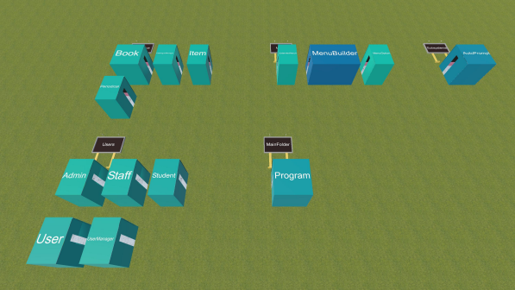
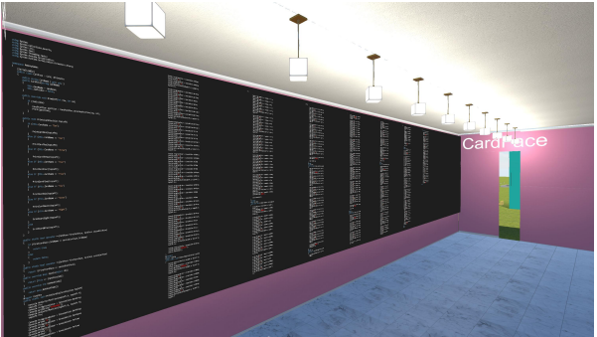
1.Introduction
(a) Top-down view of the entire codebase.
(b) Exploring the inside of a code room in first-person vieweing mode.
Fig. 1: Code Park in action.

Slide 5
1.Introduction
The contributions of exploratory work:
1) Creating an engaging and intuitive tool for improved code understanding.
2) Examining the usability of such a tool and gauging user interest.
3) Displaying the source code itself in a 3D environment(rather than a metaphorical representation) and facilitate “intimate” interaction with the code via an ego-centric mode.

Slide 6
2.Related Work
based on 2D environments:
Code Bubbles、Code Gestalt、The class blueprint.......
based on 3D environments:
solar system metaphor、CodeCity 、Vizz3D、Evospaces......

Slide 7
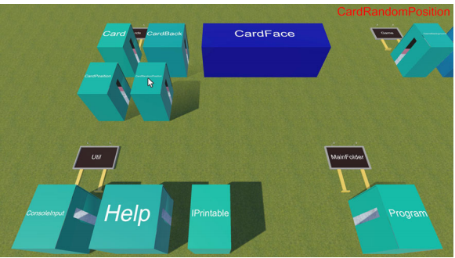
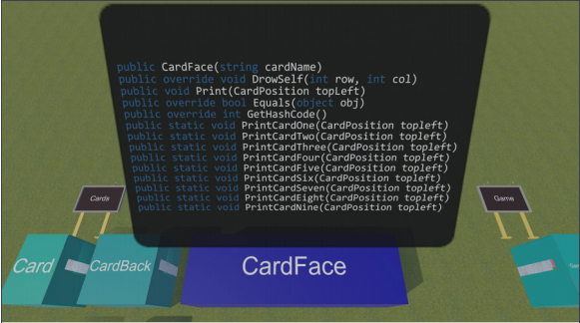
3.User Interface Design
(a) Bird's view with tooltip on top-right.
(b) Class method overview tooltip.
Fig. 2: V arious CP view modes and features.

Slide 8
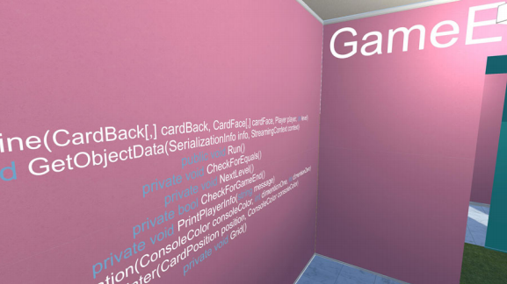
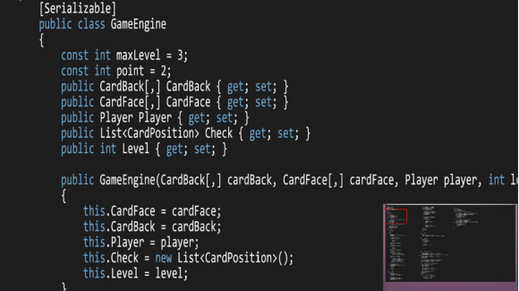
3.User Interface Design
(c) Class method overview wallpaper.
(d) Code reading view.
Fig. 2: V arious CP view modes and features.

Slide 9
4.Evaluation:Code Park Usability
H1: A project organized in a 3-space, city-like environmentwill be easier to learn.
H2: A project organized in a game-like environment will bemore engaging.
H3: The move to 3-space will not make working with sourcemore difficult.

Slide 10
4.Evaluation:Code Park Usability
Participants and Equipment
28 participants from University of Central Florida,they should be familiar with the C# language and also have prior experience with VS.
a 50-inch Sony Bravia TV used as the computer screen. The users used Visual Studio 2013 Community Edition and Unity3D v5.4.0 on a machine running Microsoft®Windows 10 64-bit equipped with 16.0 GB of RAM,Intel®CoreTMi7-4790 processor with 4 cores running at 3.60 GHz and NVIDIA GeForce GTX 970 graphics processor.

Slide 11
4.Evaluation:Code Park Usability
Experiment Design and Procedure
The threat to the validity of result:
(1)VS has been in development for many years and most C# developers work with VS frequently.
(2)focusing on a purely within-subject design presents other complications.
(3)studying and learning someone else’s code can quickly become tedious and the users can become fatigued after using the first tool, affecting their performance in the second tool.

Slide 12
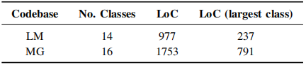
4.Evaluation:Code Park Usability
Experiment Design and Procedure
Table I: Comparison of the two codebases used in the user studies

Slide 13
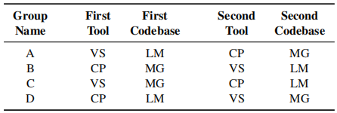
4.Evaluation:Code Park Usability
Experiment Design and Procedure
Table II: Different experiment groups.

Slide 14
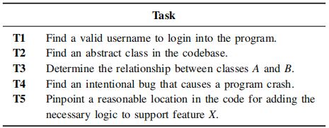
4.Evaluation:Code Park Usability
Experiment Design and Procedure
Table III: Participant tasks.

Slide 15
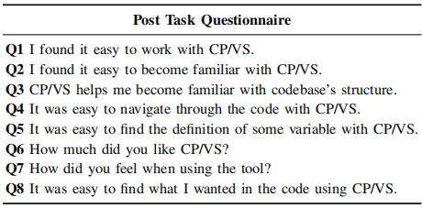
4.Evaluation:Code Park Usability
Metrics
Table IV: Post-task questionnaire.

Slide 16
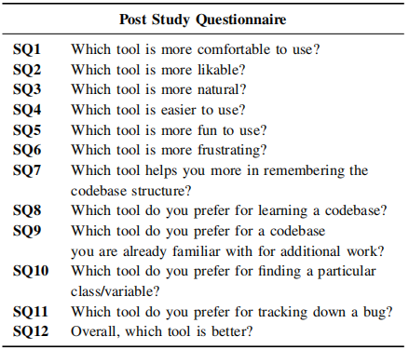
4.Evaluation:Code Park Usability
Metrics
Table V: Post-study questionnaire.

Slide 17
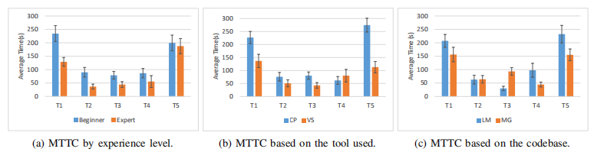
4.Evaluation:Code Park Usability
Quantitative Results
Fig. 3: Mean time to task completion (MTTC).

Slide 18
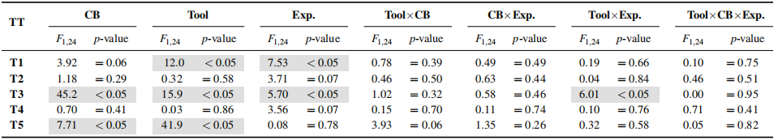
4.Evaluation:Code Park Usability
Quantitative Results
Table VI: ANOV A results on the quantitative data (time to task completion).

Slide 19
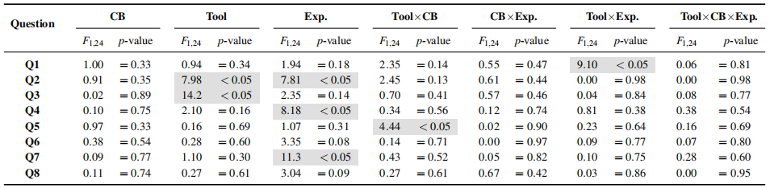
4.Evaluation:Code Park Usability
Qualitative Results
a) Post-Task Questionnaire:
Table VII: ANOV A results on the qualitative data (post-task questionnaire).

Slide 20
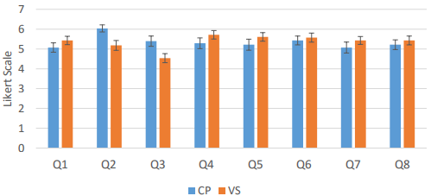
4.Evaluation:Code Park Usability
Qualitative Results
a) Post-Task Questionnaire:
Fig. 4: Mean responses to the post-study questionnaire for CP and VS.

Slide 21
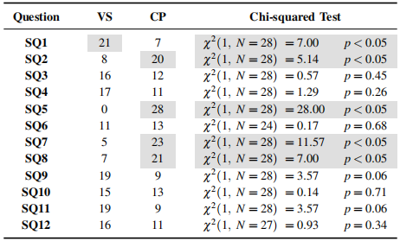
4.Evaluation:Code Park Usability
Qualitative Results
b) Post-Study Questionnaire:
Table VIII: Chi-squared analysis on the post-study responses.

Slide 22
4.Evaluation:Code Park Usability
Discussion
CP significantly easier than VS.
CP to be significantly more beneficial in becoming familiar with a codebase compared to VS.
CP to be more likable compared toVS.
CP not only helped in learning the code structure but also helped them in remembering the code they studied and also finding the code elements that they were looking for.
there was no significant difference observed in users’ responses between CP and VS.
beginners found CP to be easier to work with. Conversely, experts found VS to be easier.
CP is a more favorable tool for larger projects when finding the definition of variables.

Slide 23
5.Evaluation:Understanding Project Organization
Participants and Experience Design
9 participants.they were similar to the previous study, i.e. familiarity with the C# language.
Each participant was tasked with placing all 33 classes of an existing project in CP’s environment in a manner that they saw reasonable.participants into two groups of 5 and 4.
The classes in the project that was given to the first group were already organized into directories based on their relation.the classes in the project that was given to the second group were not organized in any particular manner.

Slide 24
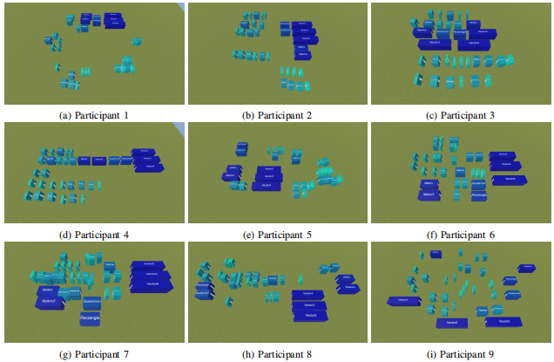
5.Evaluation:Understanding Project Organization
Results
Fig. 7: Screenshots of participants project organization.

Slide 25
5.Evaluation:Understanding Project Organization
Discussion
Goal:determine how users organize a project in CP environment in a way that the final result helped them remember the location of each class.
Result:In cases where the project files were already organized into directories, users mostly followed that same organization. if the project lacked an inherent organization, users’ decisions were guided either by the size of each class or the semantic relationship of those classes.

Slide 26
6.Limitations And Future Work
limitations
most C# developers have experience with VS and such prior familiarity could affect their responses.
comparing VS which is fast and responsive to an interface that has animations and is slower may not result in a completely fair assessment.
CP misses code editing or debugging functionalities. Also, CP currently only supports C# codebases.

Slide 27
6.Limitations And Future Work
limitations
most C# developers have experience with VS and such prior familiarity could affect their responses.
comparing VS which is fast and responsive to an interface that has animations and is slower may not result in a completely fair assessment.
CP misses code editing or debugging functionalities. Also, CP currently only supports C# codebases.

Slide 28
6.Limitations And Future Work
Future Work
address these limitations by incorporate more functionality into CP such as a code editor and a debugger.
a project to grow from buildings to districts, to cities, to regions.
evaluate CP in virtual reality (VR) and augmented reality (AR) environments.

Slide 29
7.Conclusion
Code Park to be easy to learn, instrumental in understanding as well as remembering the structure of a codebase, and enjoyable to use.

Slide 30
THANKS

